Slide 1



PHARMACY PORTAL ANDROID APP
By Hritaban Ghosh 19CS30053

Slide 2


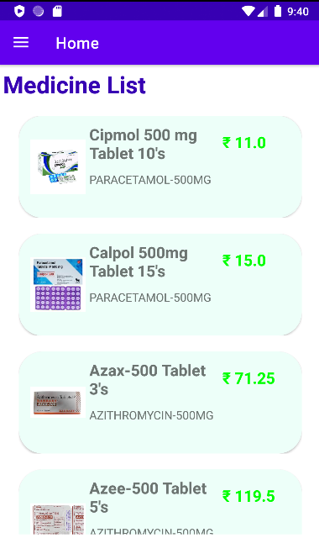

PHARMACY PORTAL ANDROID APP
The pharmacy portal is built to provide the customers with a online portal using which they can easily view the pharmacy at a glance without physically visiting it.

Slide 3




DESIGN CHOICES
Back-end Database: SQLite
Mobile Operating System: Android
Language Used: Java

Slide 4
WHY SQLITE?
Open-source and Lightweight
Store data in User device in the form of a Text file
Zero Configuration Database
Serverless
Secure

Slide 5
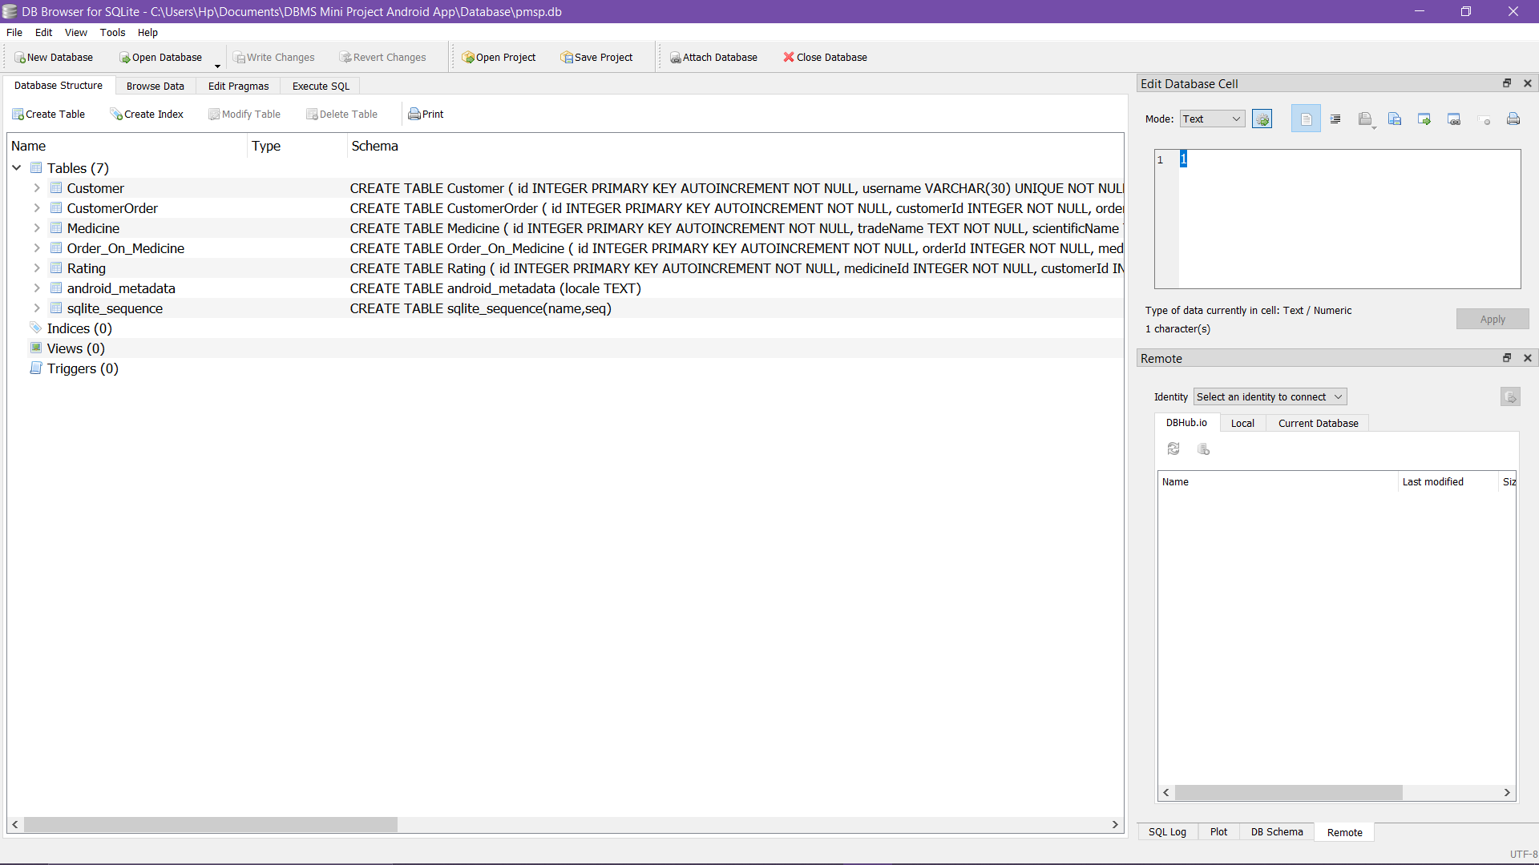
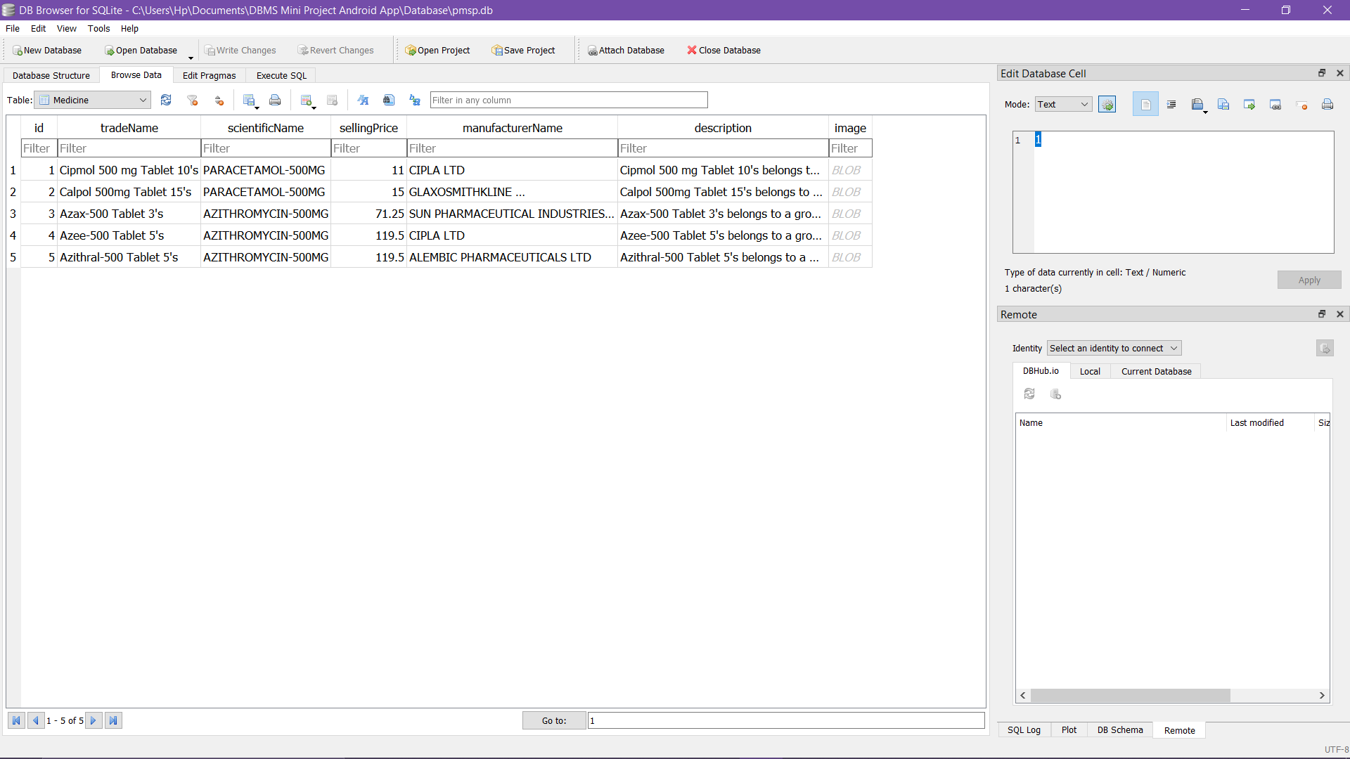
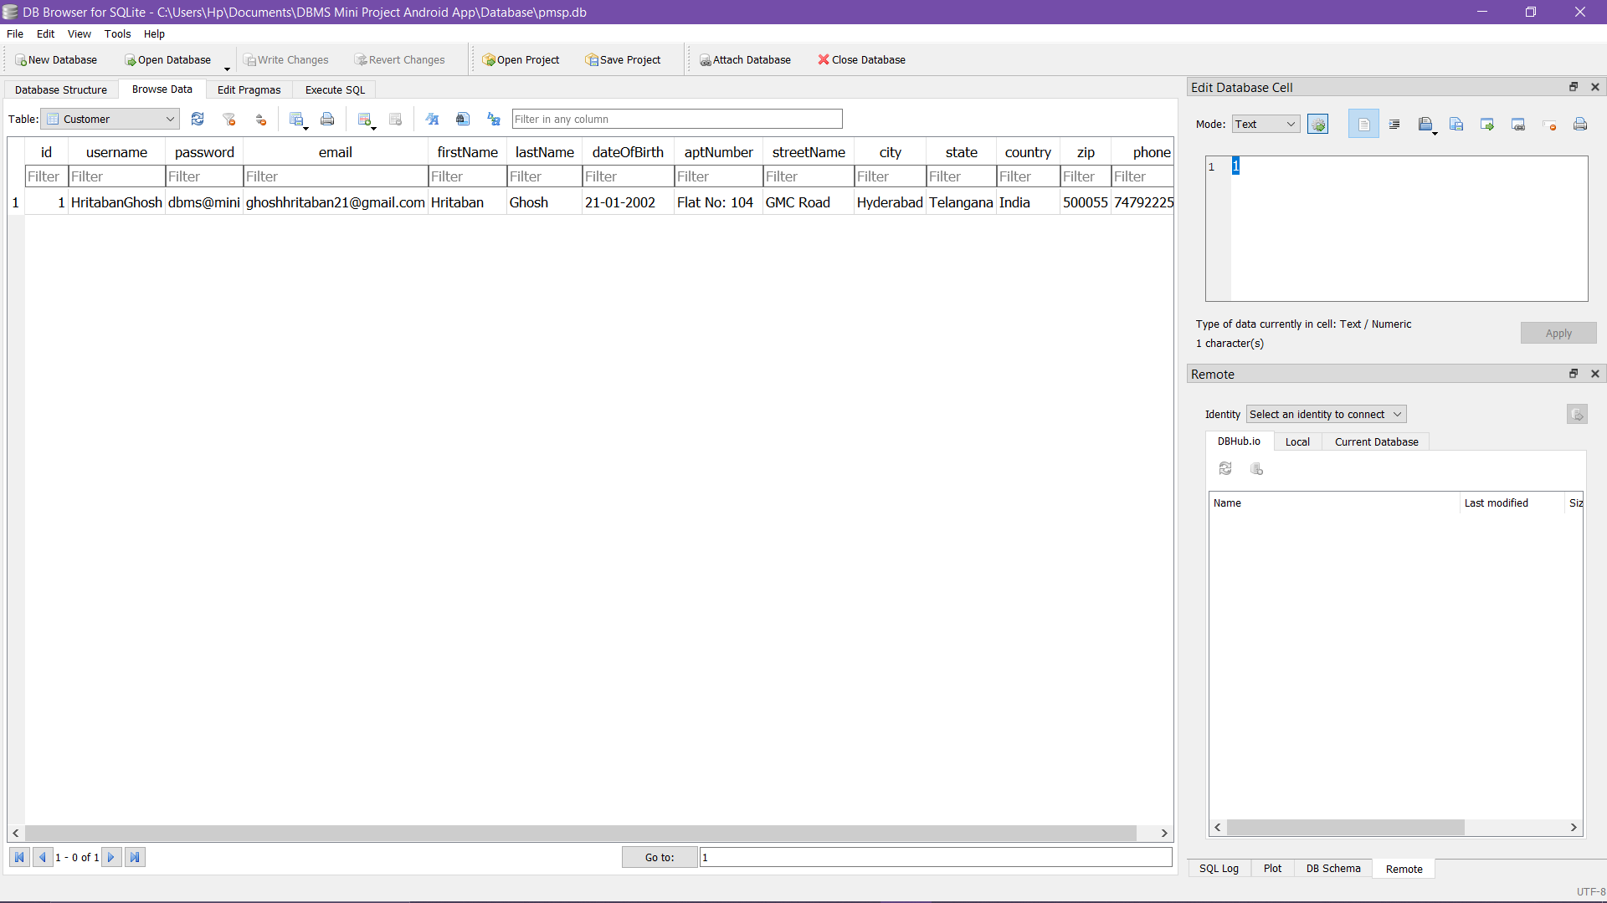

Slide 6


FEATURES
All the features of the Pharmacy Portal Android App will be discussed in detail in the following slide.

Slide 7
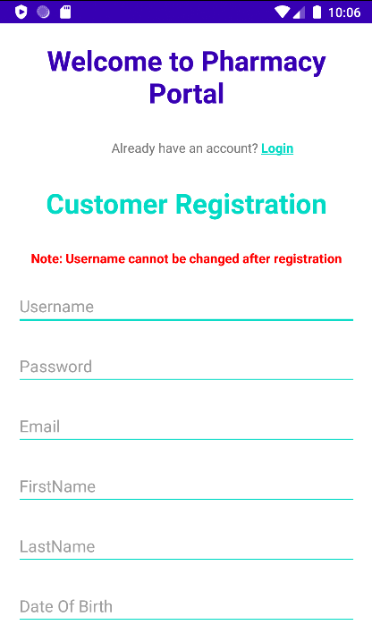
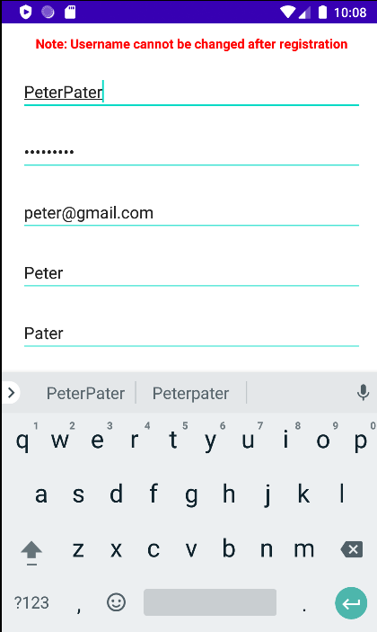
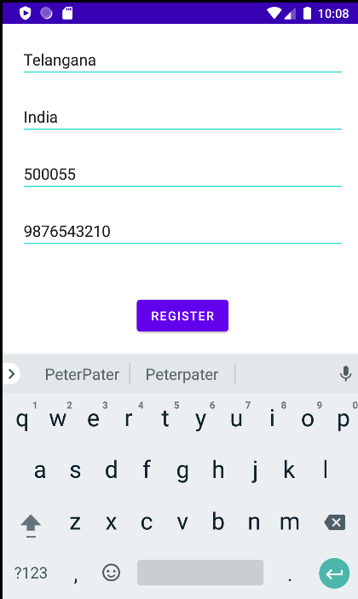
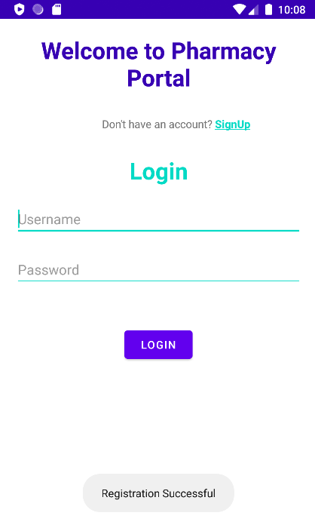
FEATURE 1 : REGISTER AS CUSTOMER

Slide 8
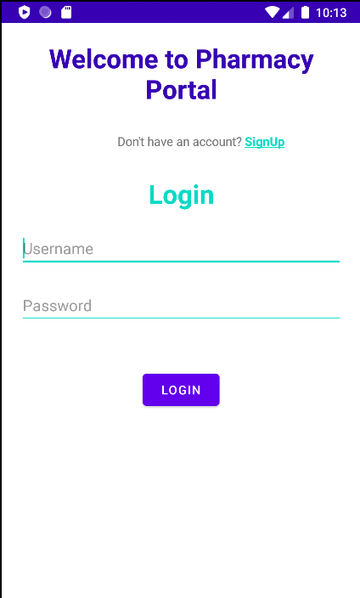
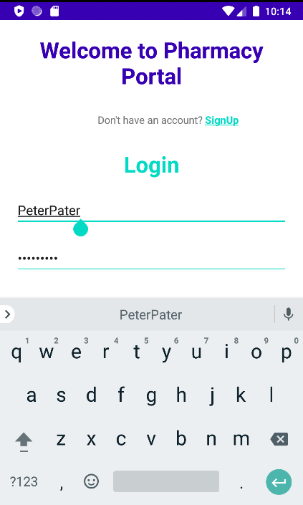
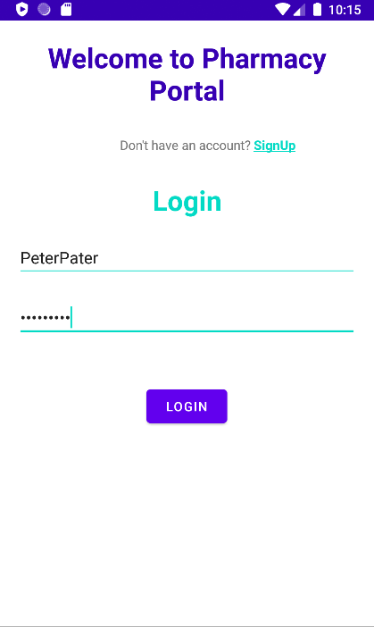

FEATURE 2 : LOG IN

Slide 9
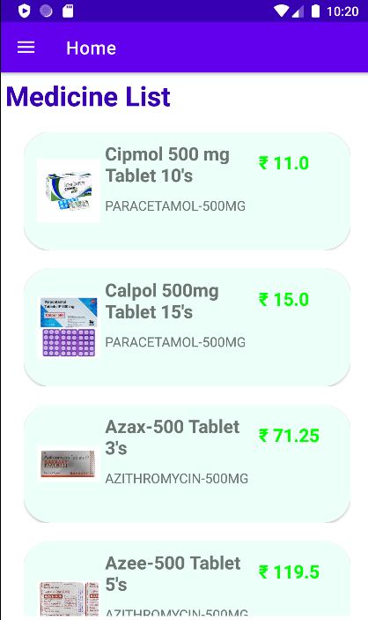
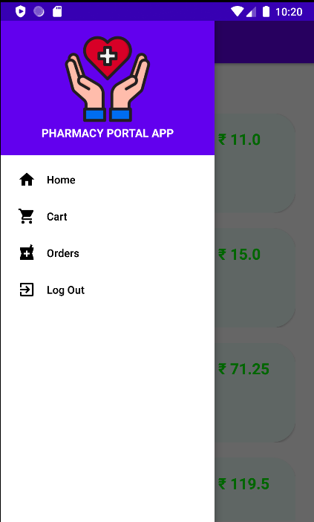
FEATURE 3 : NAVIGATION BAR

Slide 10
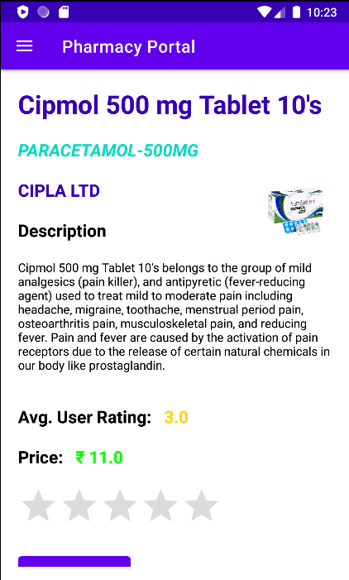
FEATURE 4 : SEE MEDICINE DETAIL

Slide 11
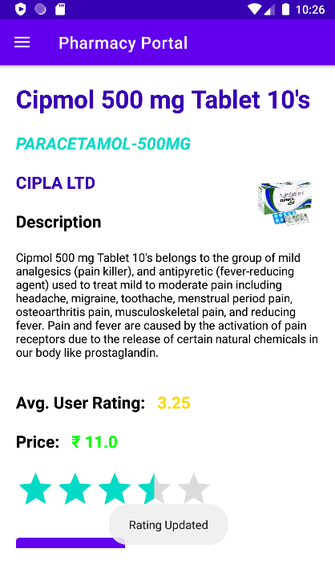
FEATURE 5 : RATE A MEDICINE

Slide 12
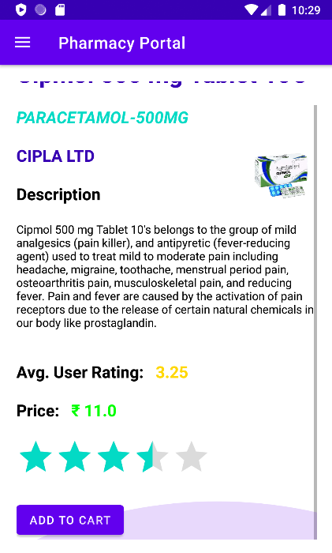
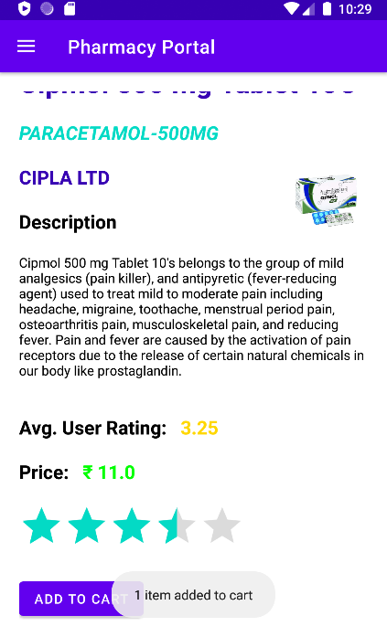
FEATURE 6 : ADD MEDICINE TO CART

Slide 13
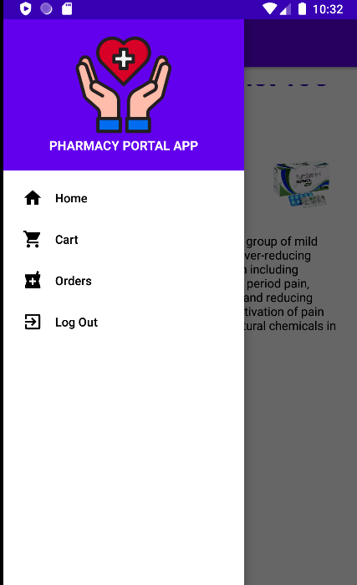
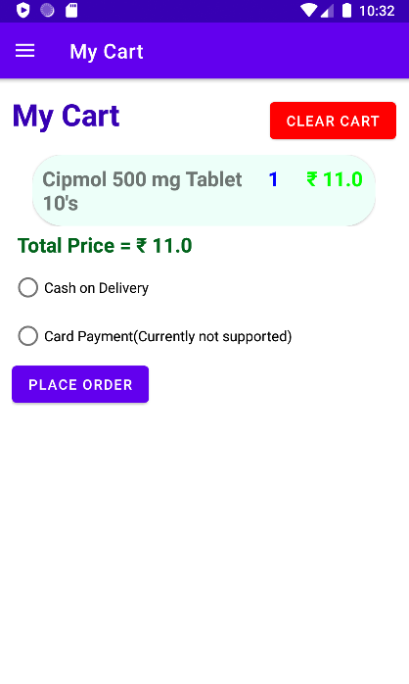
FEATURE 7 : VIEW CART

Slide 14
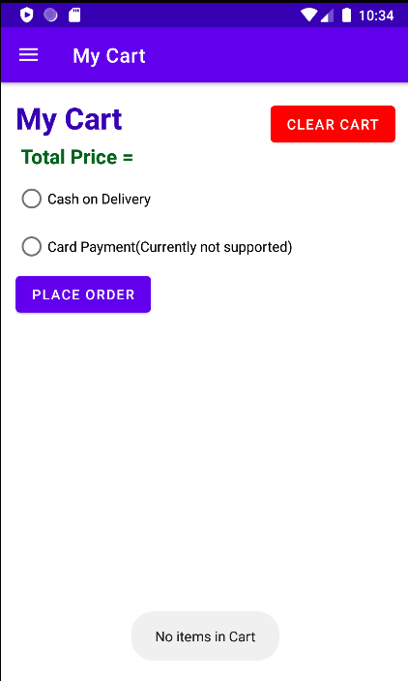
FEATURE 8 : CLEAR CART

Slide 15
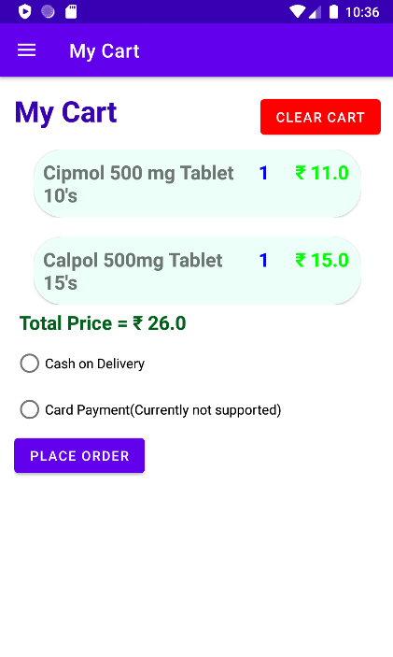
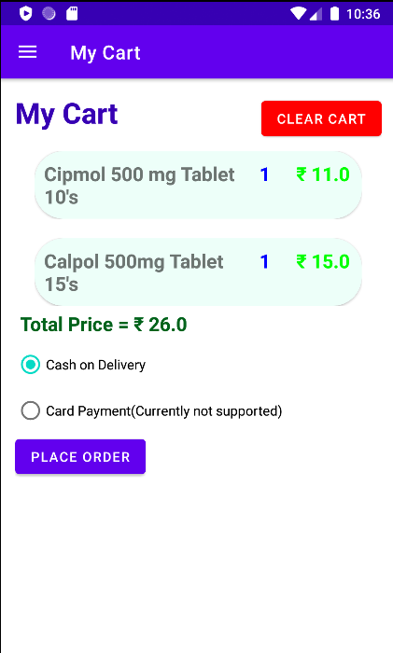
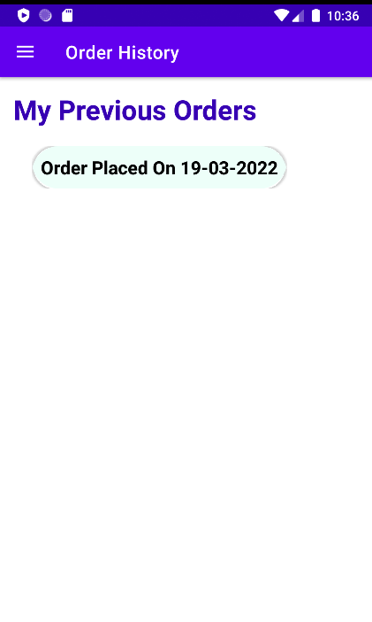
FEATURE 9 : PLACE AN ORDER

Slide 16
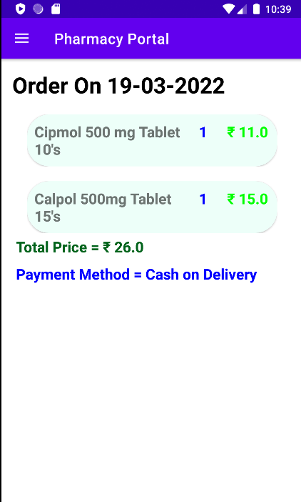
FEATURE 9 : VIEW ORDER DETAILS

Slide 17
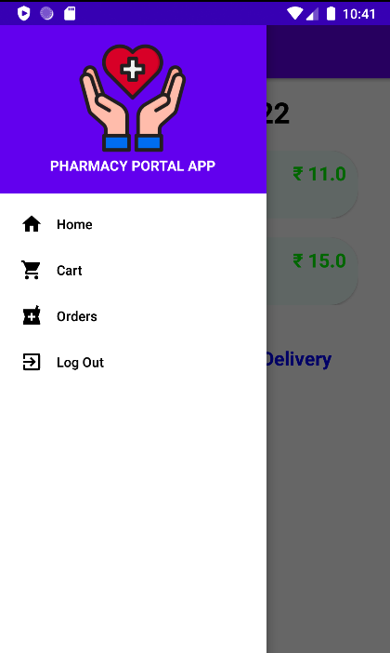
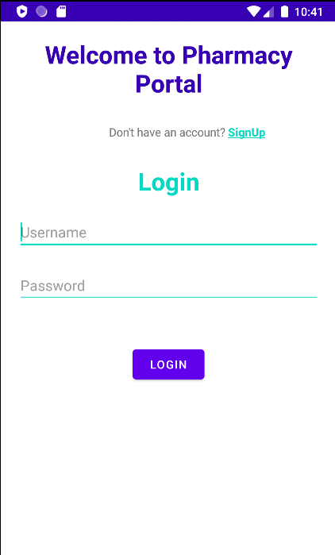
FEATURE 10 : LOG OUT

Slide 18
Add Support for Card Payment
Add different views for Vendor and Staff
Enhance user Experience
FUTURE WORKS

Slide 19
THANK YOU!
Hritaban Ghosh 19CS30053

